Slide 1

Introduction to Jenkins
Module 7: Remote API and Automation

Slide 2
Topics
REST API overview and authentication
Triggering builds from scripts
Querying jobs and logs
Python and curl examples

Slide 3
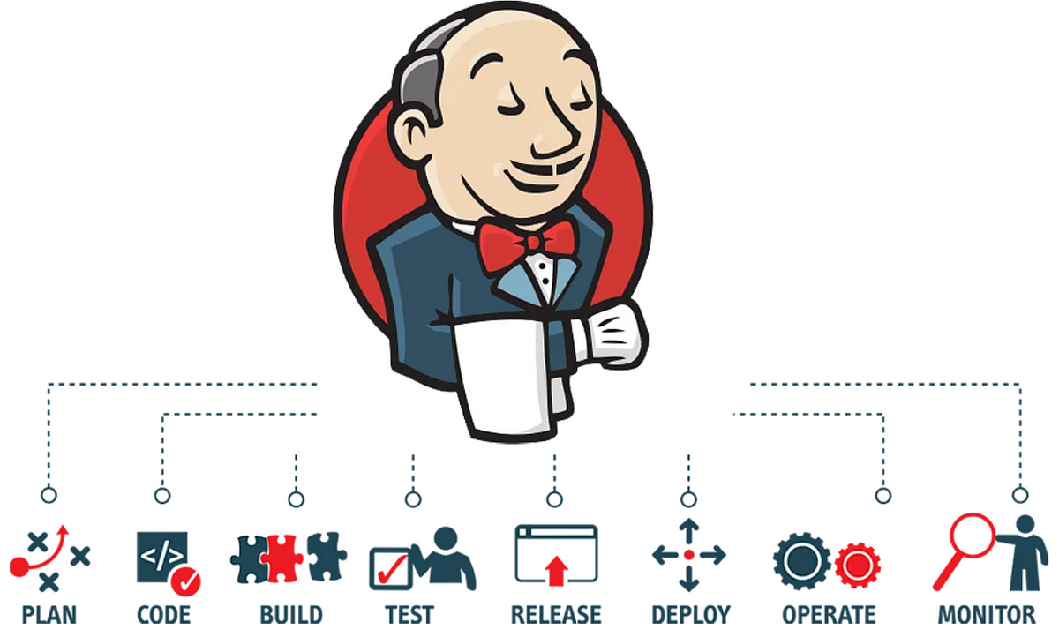
Jenkins Remote API
Jenkins exposes a REST-style HTTP API
  Allows external systems and scripts to interact with Jenkins programmatically.
Using the API, clients can
  Trigger builds
  Check job and build status
  Retrieve console output
  Integrate Jenkins with other tools and systems
Almost every object in Jenkins
  Has a URL
  Can return structured data (JSON or XML)
  Adding /api/json to a Jenkins URL typically returns JSON data.

Slide 4
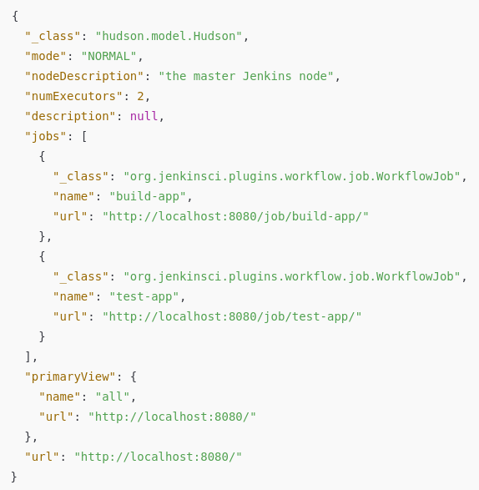
API URL Structure
Using the class lab URL
  Jenkins root
    http://localhost:8080/api/json
  Returns metadata about the Jenkins server, such as:
    Jenkins version
    Server description
    Executor information
    List of top-level jobs
    Primary view
    System mode (NORMAL / EXCLUSIVE)
    URLs to other API endpoints
  This is read-only information
    Used by dashboards, scripts, and discovery tools.

Slide 5
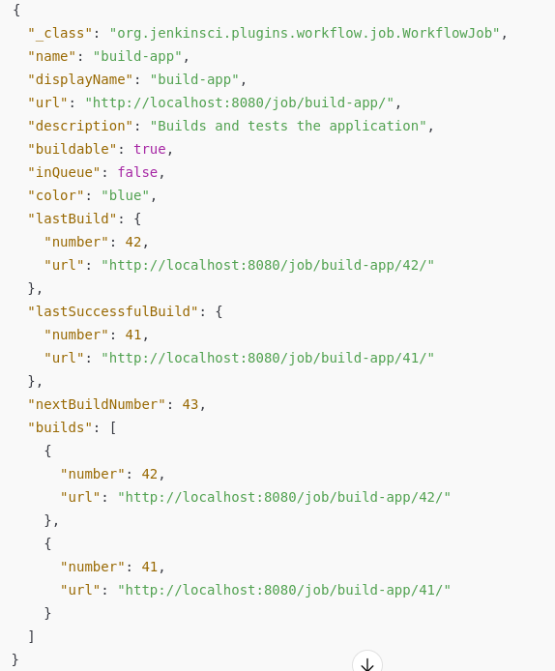
Job API URL Structure
Using the class lab url
  Job metadata:
    http://localhost:8080/job/<job-name>/api/json
  Returns metadata about a job
    Job identity (name, URL, type)
    Whether the job is enabled or buildable
    Overall job status (based on last run)
    Build history (list of builds)
    Last build
    Last successful build
    Last failed build
    Next build number
    Queue status

Slide 6
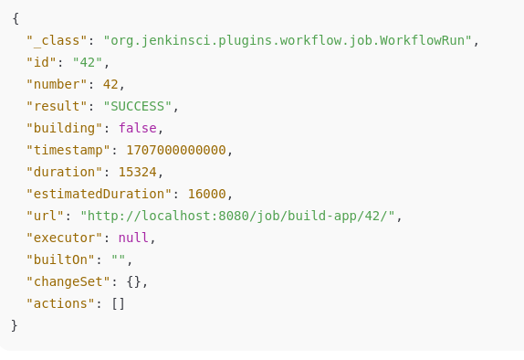
Build API URL Structure
Using the class lab url
  Build metadata:
    http://localhost:8080/job/<job-name>/<build-number>/api/json
  Returns metadata about a build
    Build number and ID
    Build result (SUCCESS, FAILURE, etc.)
    Whether the build is currently running
    Start time and duration
    Agent used
    Build parameters
    Source control changes

Slide 7

Triggering a Build
The POST command is used to trigger a build for a job
  This requires the use of an API token for authentication
  Returns a “201 Created” on success
  The “build” endpoint is used for builds without parameters
  The example below triggers a new build for
    Job “Demo1”
    User “Rod”
    API Token “11fbc4d3b17ad053c3276ff199f25ff773”
curl -X POST -u Rod:11fbc4d3b17ad053c3276ff199f25ff773 http://localhost:8080/job/Demo1/build

Slide 8
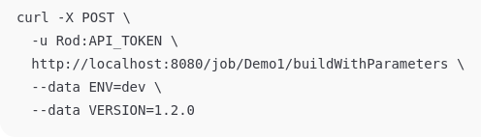
Triggering a Build
If the build is parameterized, these are passed in the body as shown in the example on the right
  Note that the API endpoint is “buildWithParameters”

Slide 9

Last Build Shortcut
Get the most recent build without knowing the build number
  GET /job/<job-name>/lastBuild/api/json

Slide 10
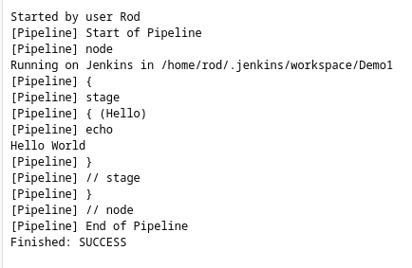
Console Logs
Retrieve raw console output for a build.
  GET /job/<job-name>/<build-number>/consoleText
http://localhost:8080/job/Demo1/15/consoleText

Slide 11
Questions

